Slide 1
Building a transformer for DNA mutation identification
Ronak Agarwal

Slide 2
Project introduction
Basics:
Transformer on DNA
Why this project:
Interesting
Great learning experience
Significance:
Predictive power over gene sequences

Slide 3

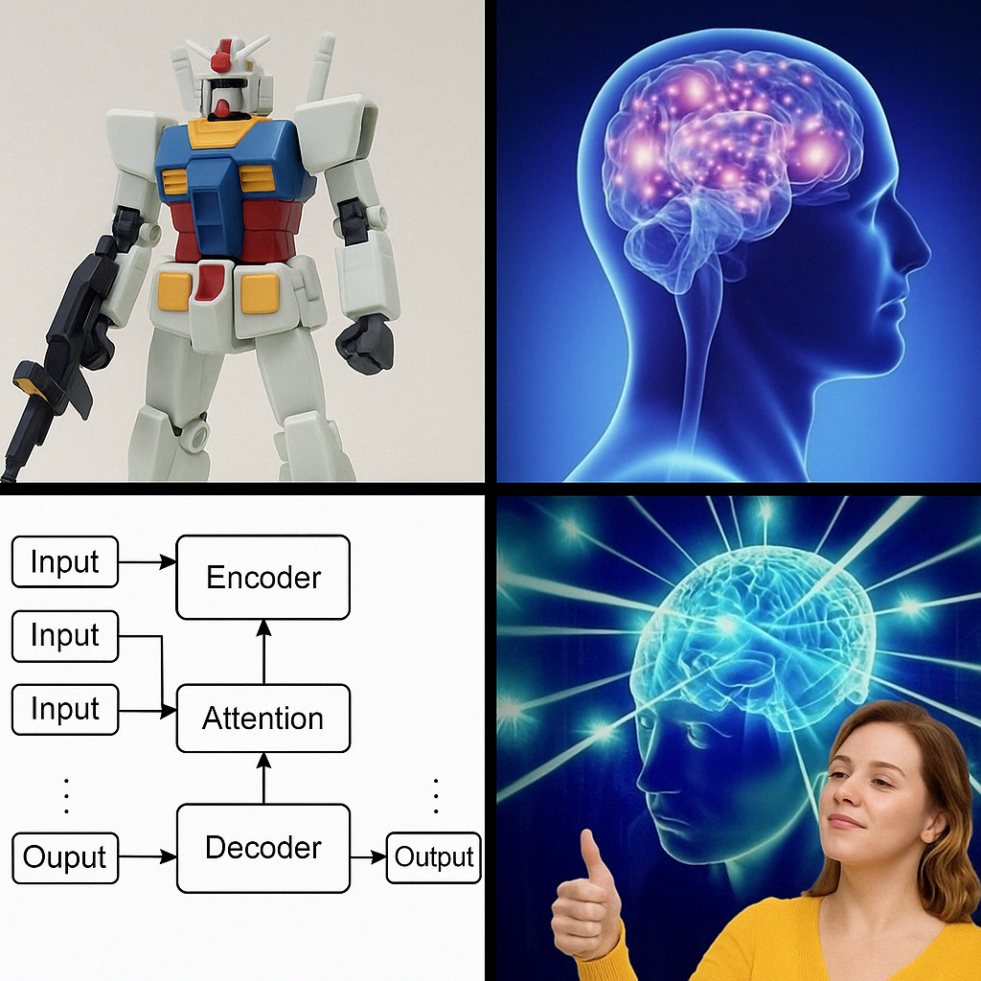
Basics
Image produced with chatGPT
Use transformer self-attention model to predict DNA sequences
Goal is to learn details of how a transformer works by building self-attention mechanism from linear layers
Another more “novel” thing I’m going to try to do is combine Hamming distance with the output from the model to predict mutations
Long term, if we start with a sequence it would be cool to try generating novel synthetic proteins
Probably outside scope of this project
Would be hard to shape the “context” to form something with a targeted functionality
Hard to test predictions

Slide 4
What drew me to the project
First, the idea of intelligently predicting a codon based on past codons is such a complicated, interesting question
Transformers seem to naturally fit into this environment: they encode context, have the capacity to learn incredibly intricate rules
Codons also make a great token
But mutations aren’t on the level of tokens, they are on the level of base-pairs
Also super interesting to generalize the problem (see next slide)

Slide 5
Significance of project
Creates parallels to wide range of other problems
E.g. decoding drunk text based on context, cohesion, patterns of speech tailored to the person, and QWERTY distance
Would be useful to be able to analyze gene sequences
Would be useful to measure “cohesion” of proposed gene sequence
Would be useful to correcting mutations using both nucleotide Hamming distance and transformer cohesion

Slide 6

Ethics
Data privacy depending on genome

Slide 7
Data processing pipeline
Data collection/cleaning
Want a big list of lists; each list represents a gene DNA sequence (with starting/stopping codons and no errors/mutations)
Model training
Train a transformer, learn to use MLX on my mac
Build transformer from semi-scratch (like I’ll use pytorch, but not the built in transformer)
Model predictions:
Making novel strands, simulating in alpha fold
Make mutation, seeing if I can use model to catch it

Slide 8
Data cleaning and visualization
Data: http://bacteria.ensembl.org/info/about/species.html
Downloaded exon sequences, parsed with library
Cleaning:
Size limits; multiple of 3 BP length; No “N”
Convert 3-BP sequences → amino acid/signal/token
After convert to tokens, start with “11” ends with “0”

Slide 9
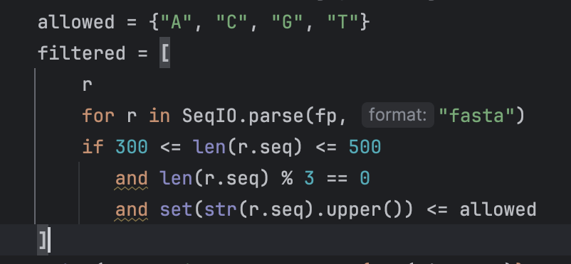
Code
Read from “.fa” file format into string of letters
Filter: length; 0 mod 3; no invalid character:
String of letters → sequence of integers corresponding to the communicated amino acid/start/stop message: used dictionary mapping

Slide 10
Understanding the data
Distribution of length of genes before cleaning
Spike at about 200 codons (600 bp)
Wanted genes of generally similar length, so took between 500 and 650

Slide 11
Model training
How a transformer works (basic):
One-hot encoding: not have metric on space
Key, query, value in single head of attention
Analysis of data
Improvements to make after first attempt:
Remove duplicate genes or configure some sort of prior
Scale up (more data, more parameters, more compute)

Slide 12
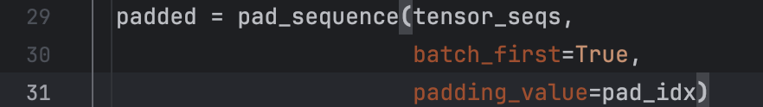
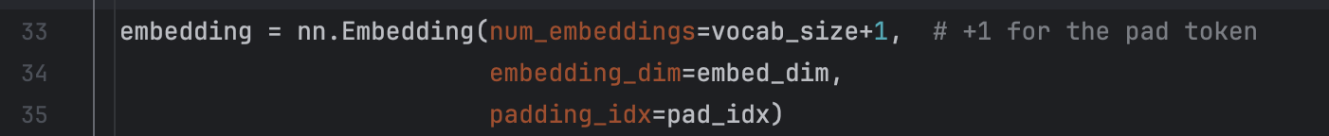
Padding and one-hot encoding
Padding: because different genes have different lengths, have a “blank space” character
One hot encoding: convert from integer k → vector of 0’s with a 1 in the kth index
Embedding matrix: go from one-hot vector to embedding vector by multiplying one-hot by a matrix

Slide 13
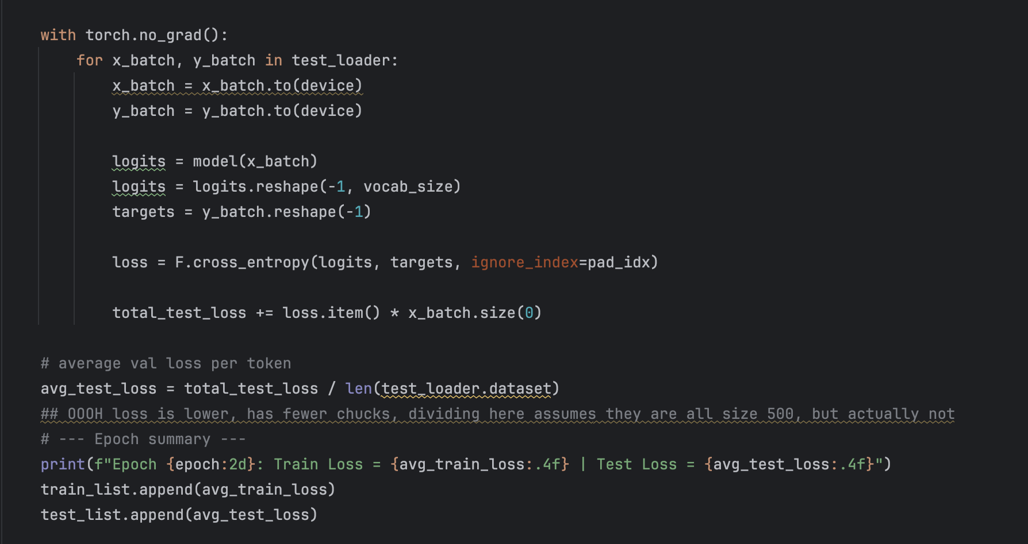
Training

Slide 14
Tracking loss through training
Red line: loss on training data
Red line: loss on test data
Note: train loss > test loss, which is normally NOT what is expected

Slide 15
Tracking loss through training (continued)
Tried testing the model when it was in “train” mode, had same inequality (but to lower extent)
More reasons: loss of train calculated for each batch during epoch
Test loss, on the other hand, calculated with model at the end of the epoch

Slide 16
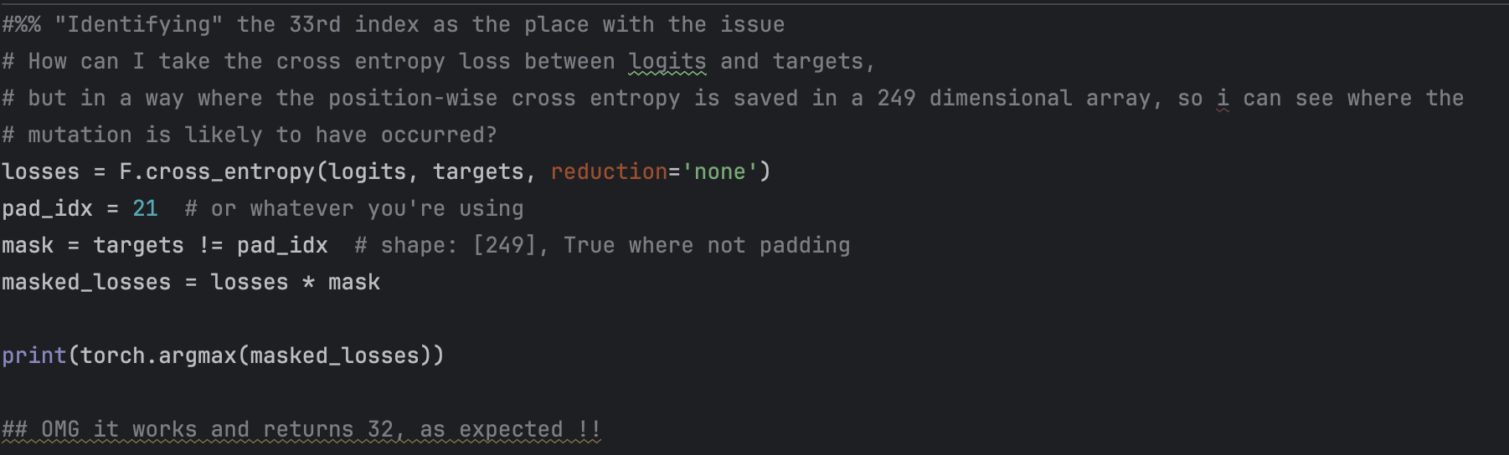
Correcting a mutation
Altered a sequence
Then ran the model, saw when the most cross entropy occurred
Correctly identified position (33) as the mutated position

Slide 17
Difficulties
Determining degree of "from scratch" to optimize learning
Large time to run model every time I wanted to implement a change
Interesting problem at higher scales of time: e.g. at OpenAI; have to be confident in code before the final training phase
Using codons as tokens means a frameshift mutation --> gibberish
Positional encoding
Actually having something to show at the end
Genuine ambiguity lower-bounding the loss (e.g. what comes after the start token isn’t as predictable as the 100th position)

Slide 18
Difficulties (continued)
Test vs train loss difference
How to evaluate model
I was able to identify a mutated location
Some problems though: needed to find a mutation that changed codon to an “unlikely” codon, some handpicking
Generally, it’s difficult to know if the model is performing well
Unlike language, can't just read it
Overfitting: don’t want it to just memorize the data, but hard to balance with lower compute
Genetic similarities between bacteria → difficulty with having a “real” test set

Slide 19
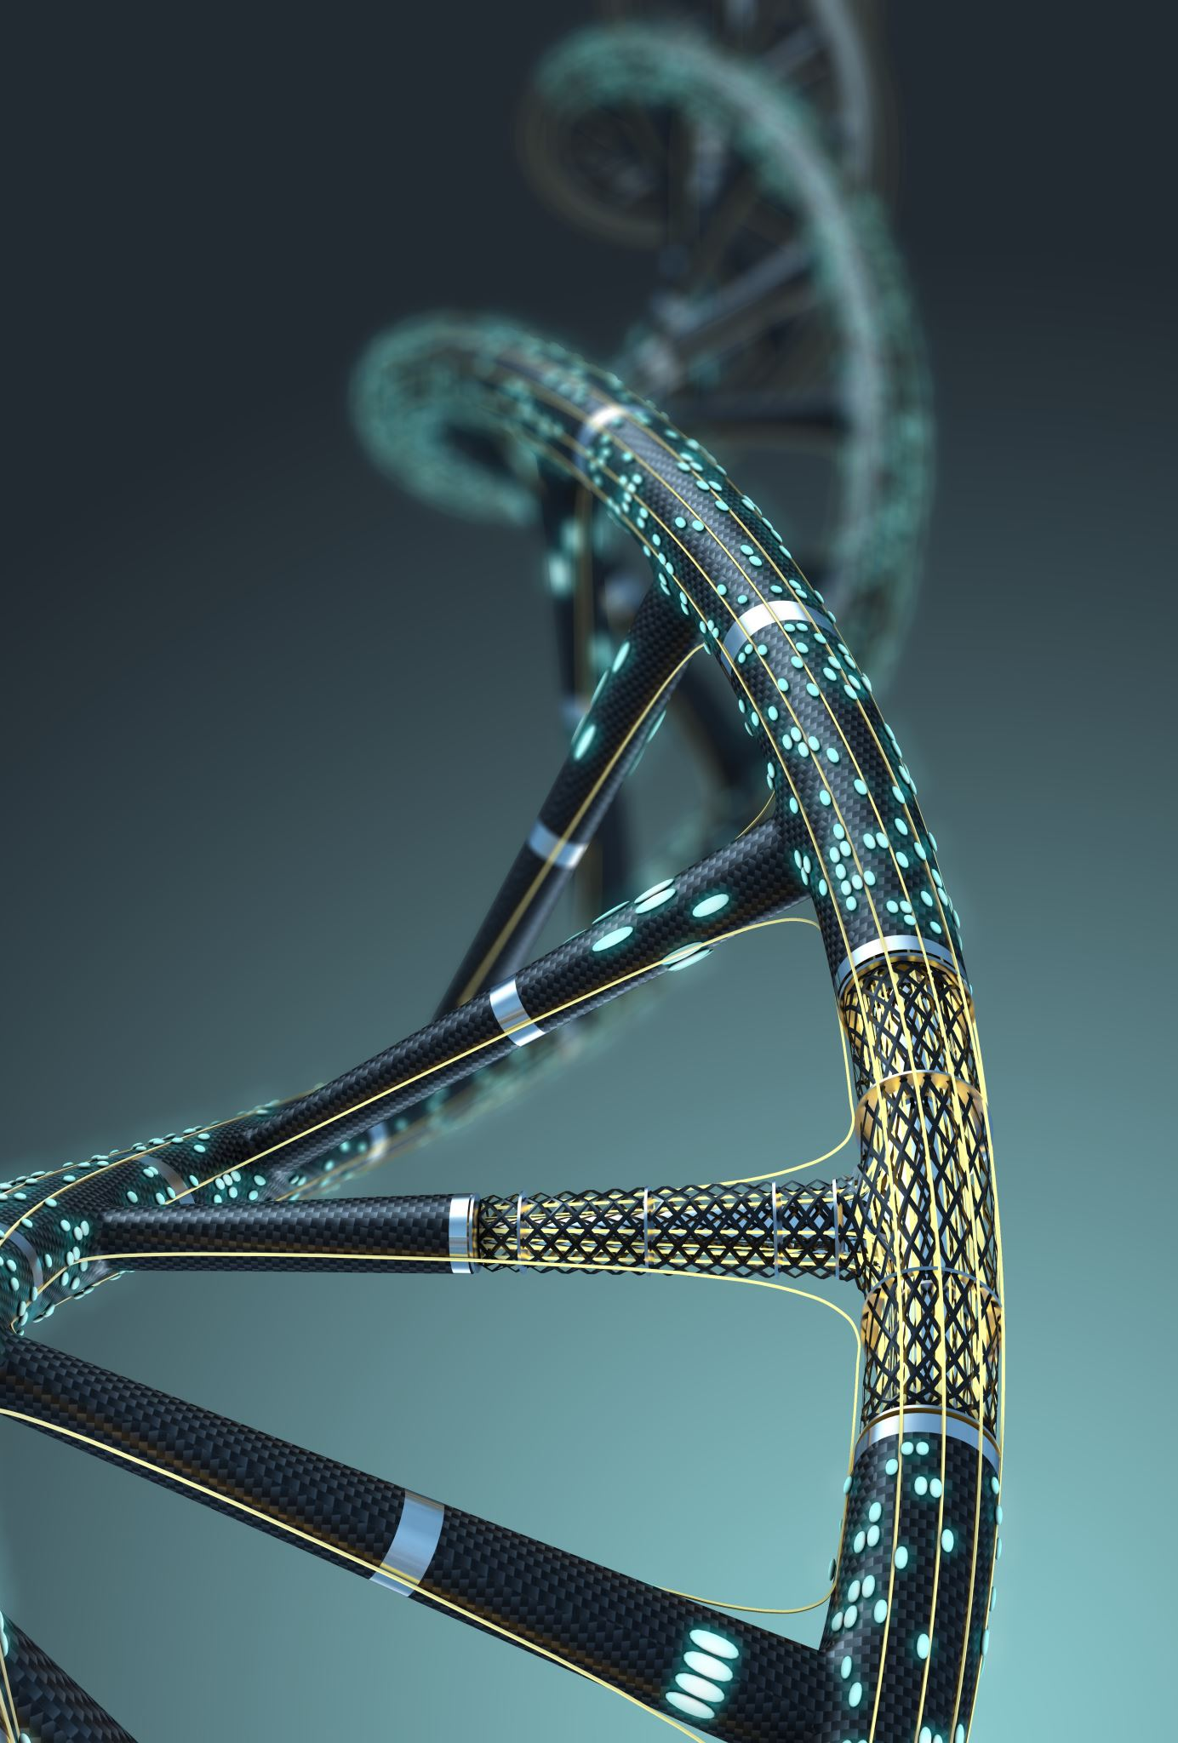
Conclusion
Summary of what was done:
Built pipeline of online data → sequences of amino-acid indices
Trained transformer model to predict next amino acid index
Plotted loss during training
Tested model by identifying gene mutation

Slide 20
Conclusion (continued)
Analyzing some results
If we look at the logits of a model prediction, we see that we generally have a couple different indices with non-trivial relative maximums
Shows that either the model didn’t have enough training data/parameters to resolve non-ambiguous choices, and/or that different genes might put different codons into a slot depending on the function of the gene
Second reason must be true, otherwise all sequences would be determined by the starting codon, no gene variety would exist
Further research
Incorporating gene function into transformer
Gene synthesis
Error-resistance communication

